Slide 1
Prediction of a patient’s length of stay at hospital at time of admission
SANKEERTHI MUMMIDISETTY
HAP -780

Slide 2

Introduction :
LOS = Time between hospital admission and discharge measured in days.
Depends on the medical condition
Average length of stay is computed for each DRG
Shorter LOS desirable:
Lower cost of care delivery
Release resources
Reduce risk of medical errors
Less chance of hospital acquired infections

Slide 3
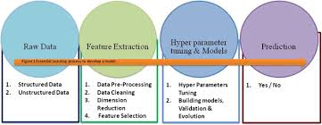
Data source:
Process to develop a predictive model:
MIMIC, an openly available dataset developed by the MIT Lab for Computational Physiology, comprising de-identified health data associated with ~40,000 critical care patients.
The dataset has 58976 number of unique admission events and 46520 number of unique patients.
Pandas, Sci-kit learn, and Seaborn libraries are used.

Slide 4
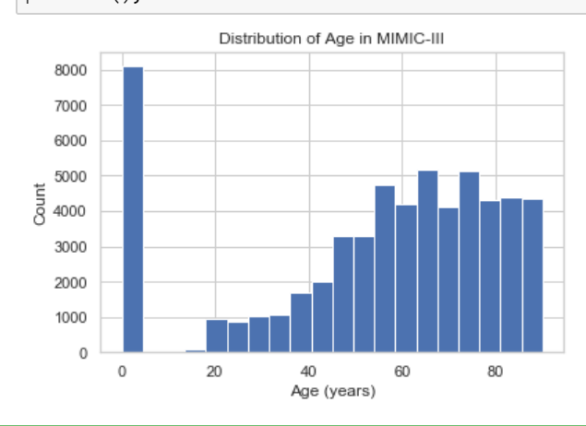
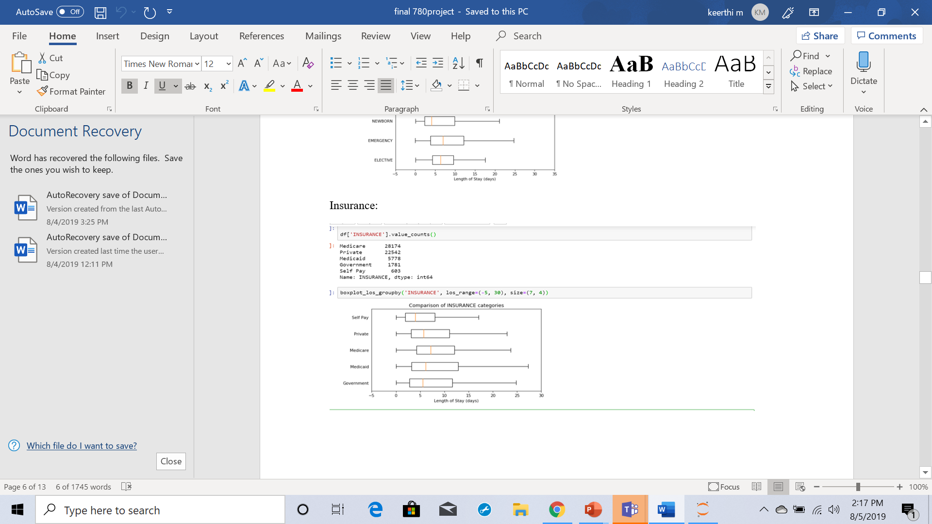
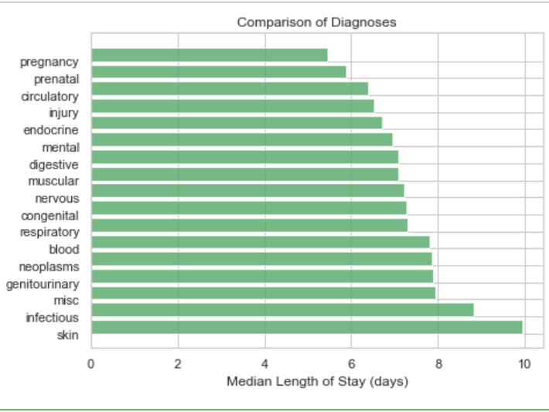
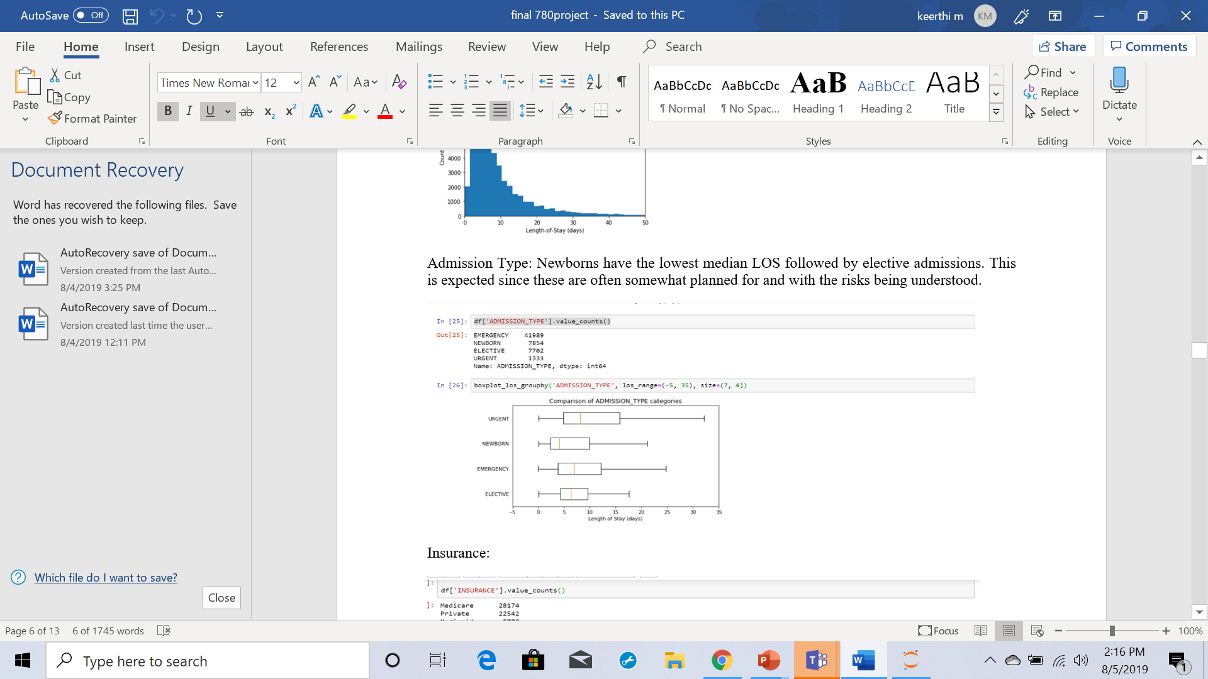
Exploratory Data Analysis
To extract the target Length-of-Stay (LOS) values and understand what independent variables used in predicting LOS.
Average length of stay has been plotted against categorical values such as length of stay, death time, ethnicity, insurance, marital status, icd9 code, age, gender.
Data set has 58976 unique admission events for 46520 unique patients.

Slide 5
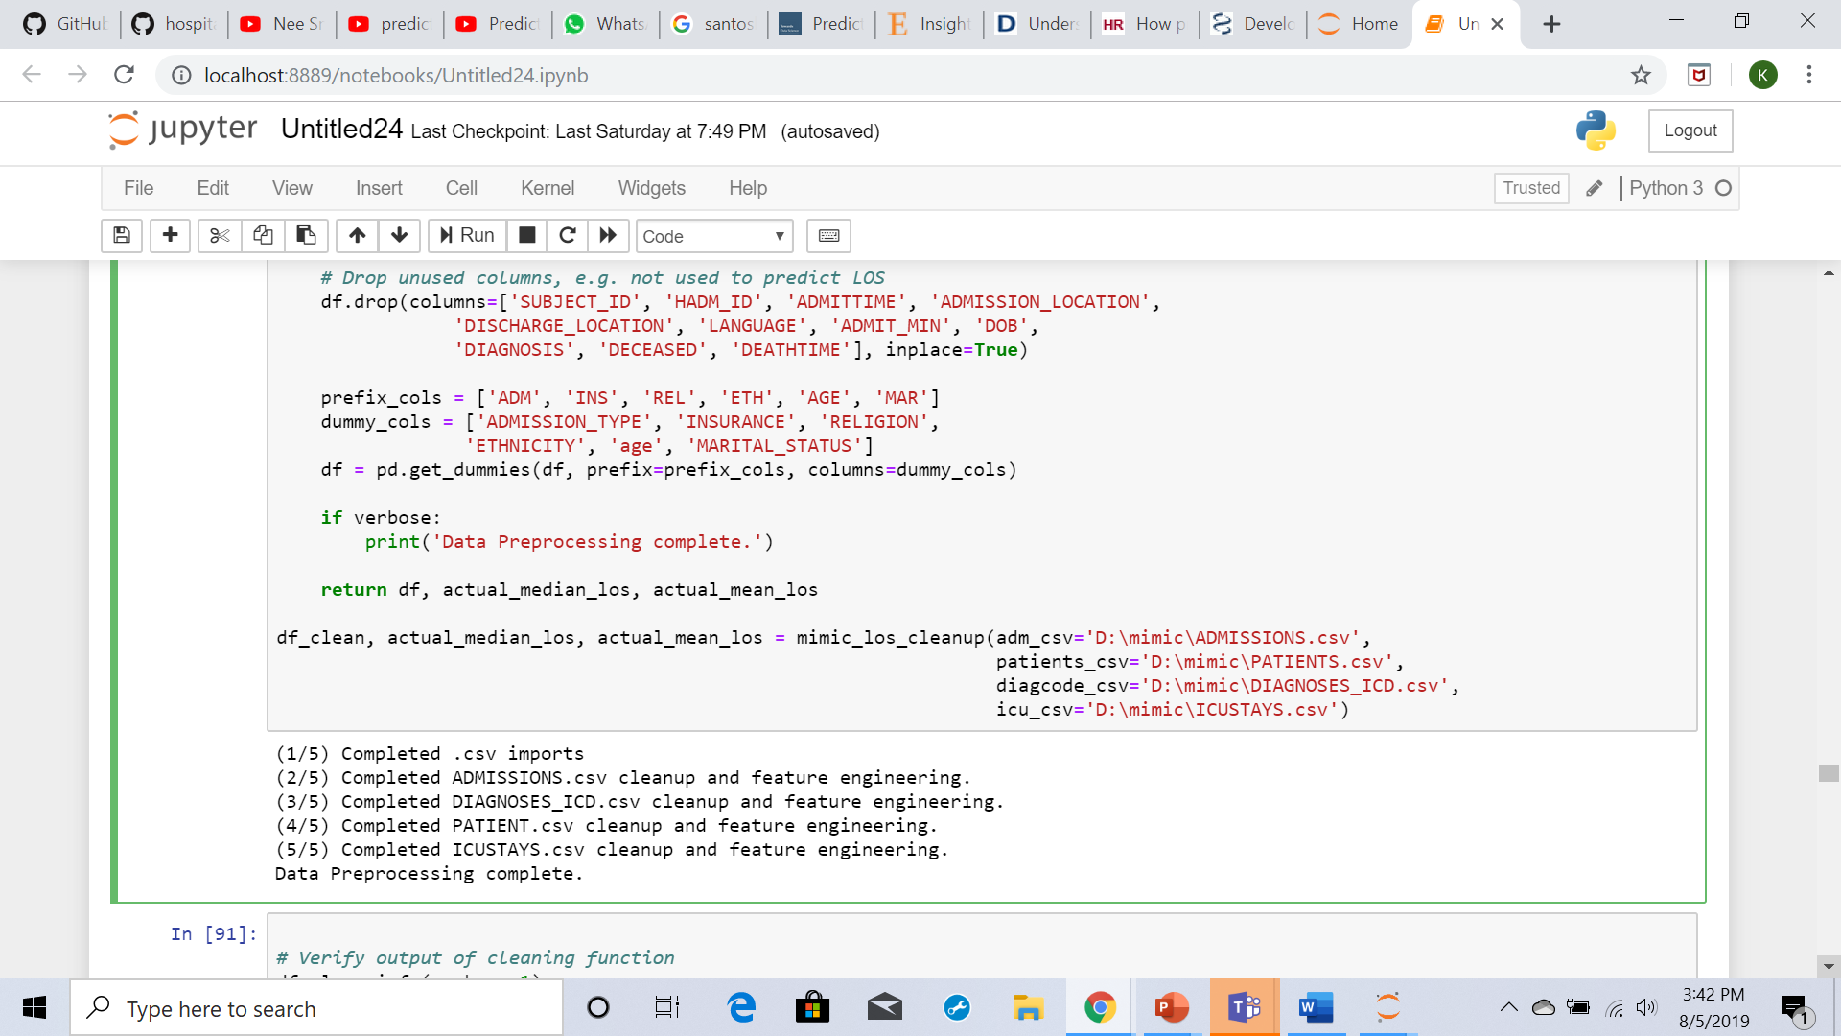
Data Cleaning and preprocessing
Dropped all unused columns and verified that no NaNs existed in the data.
Converted the categorical variables into dummy/indicator variables.
The final Data Frame size resulted in 48 feature columns and 1 target column with an entry count of 53,104.
I have used mimic_los_cleanup to clean the data and feature engineering by using this function

Slide 6
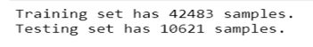
Model building:
To in order to create a model that predicts the length-of-stay for each patient at time of admission that results in a lower RMSE than the average or median models I have divided the data 80:20 ratio
scikit-learn train_test_split function.
I have used five different regression models from the scikit-learn library see what the R2 score comparison looked like.

Slide 7
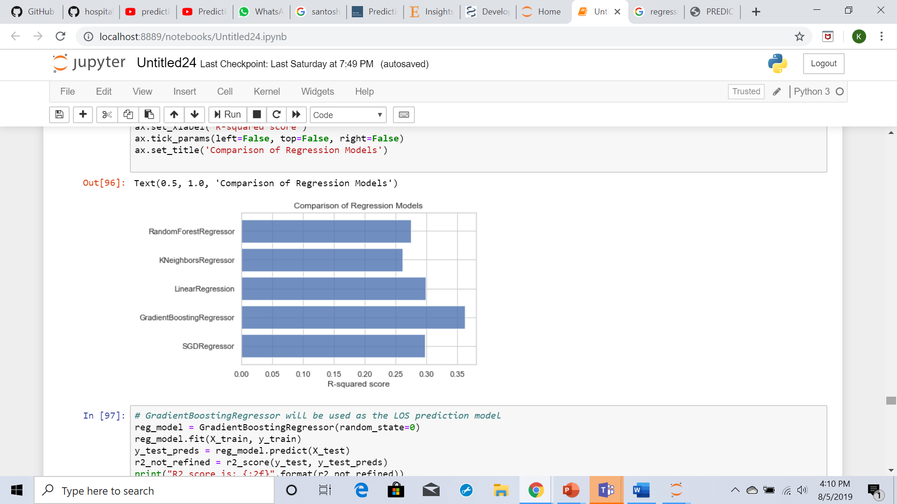
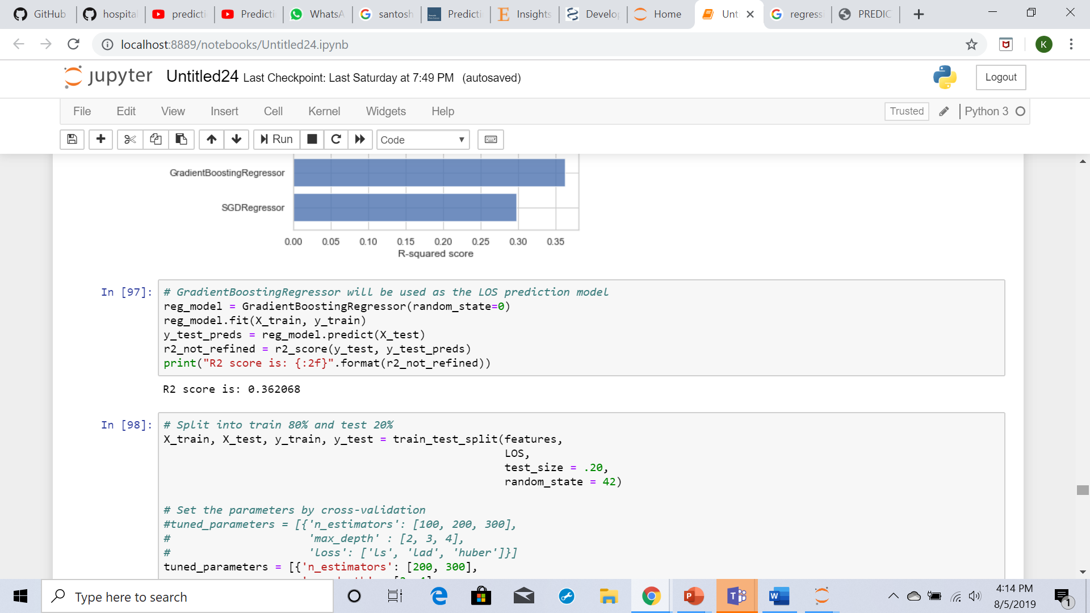
Regression models:
SGD Regressor
Gradient Boosting Regressor
Linear Regression
K Neighbors Regressor
Random Forest Regressor
It has been observed that The Gradient Boosting Regressor with an R2 score of ~37%
I have used GridSearchCV function to optimize the Gradient Boosting Regressor

Slide 8
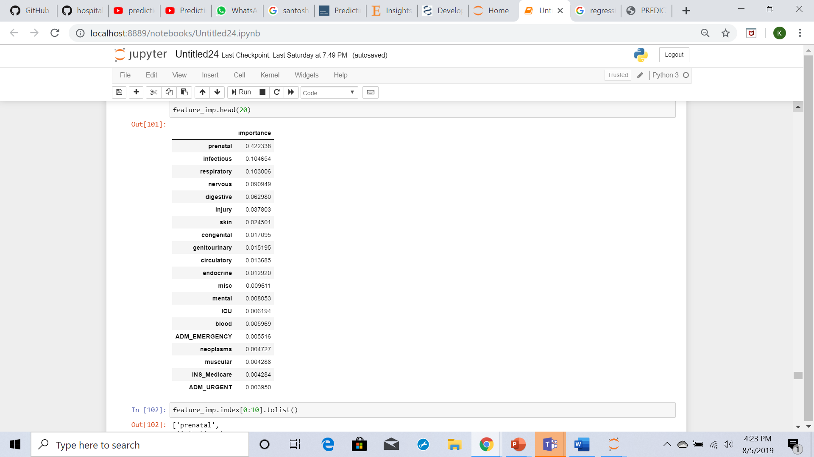
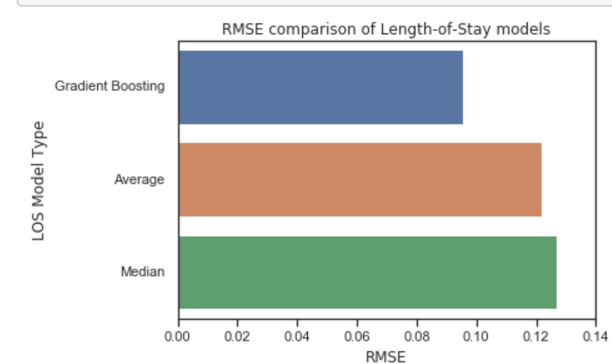
Results:
Gradient boosting model RMSE is better by more than 24% (percent
difference) versus the constant average or median models.

Slide 9
Conclusion:
The data set has 58976 number of unique admission events and 46520 number of unique patients.
It has been noticed that ICD9 play a critical role than age when predicting the length-of-stay.
I have used five different regression models (SGD Regressor, Gradient Boosting Regressor, Linear Regression, K Neighbors Regressor and Random Forest Regressor) among this done Gradient Boosting Regressor with R2 score of ~37% is given output as best model compared to other models.
Gradient Boosting Regressor score is 0.367296.
Top features for predicting Los using Gradient Boosting Regressor score are prenatal, respiratory, injury, digestive and infectious.

Slide 10
Thank - YOU

